Slide 1
Machine Learning LifeCycle
Session 1 –Prabhu Gururaj

Slide 2

Prabhu Gururaj
Previously worked in AT&T as Director – Data Science for Fraud
Based out in Dallas
Love to ski, Binge watch series , Cricket and F1
AI Enthusiast

Slide 3
6 Part AI Series
Week 1 : ML LifeCycle - Basics
Week 2 : DL/LLM / Transformers / Hugging Face / Deploying LLMs in NVDIA
Week 3 : All about GPUs and Inferencing
Week 4 : RAG, Vector DB, Agents - Basics
Week 5 : Advanced RAG - Multimodal , Graph RAG
Week 6 : AI in Netapp – Demo & Deployments - Mesfin (Protection (Ransomware , breach)) - Phani(Classifiers, GuardRails , Data Services AI) / Ashwin

Slide 4
Today’s Agenda
Intro
ML/AI in Netapp
ML Primer
Demo
ML Ops

Slide 5
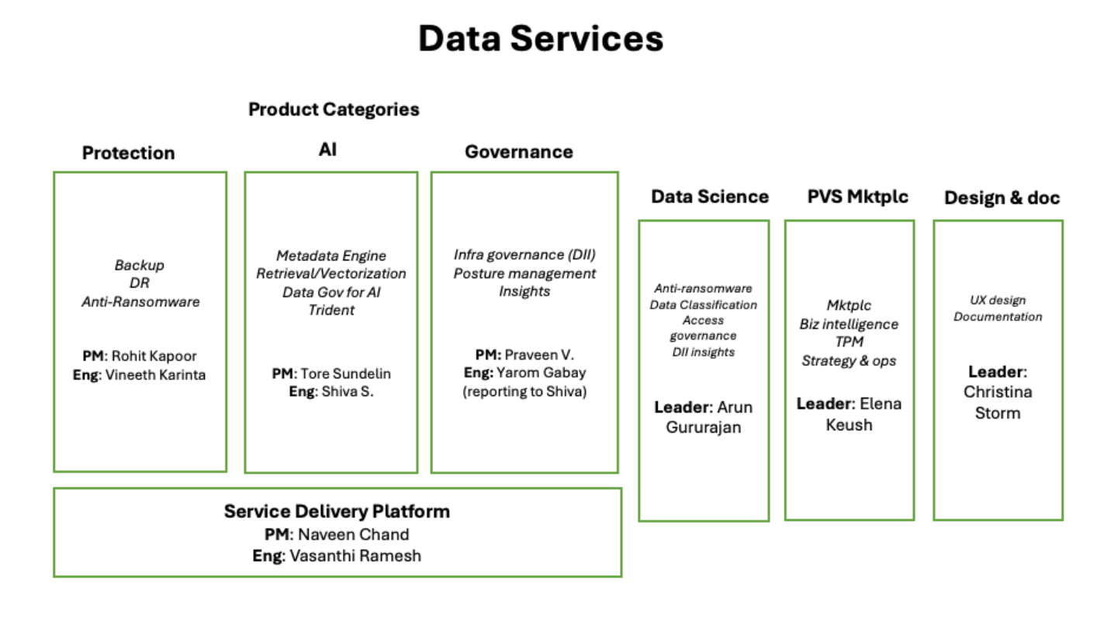
ML /AI in netapp

Slide 6
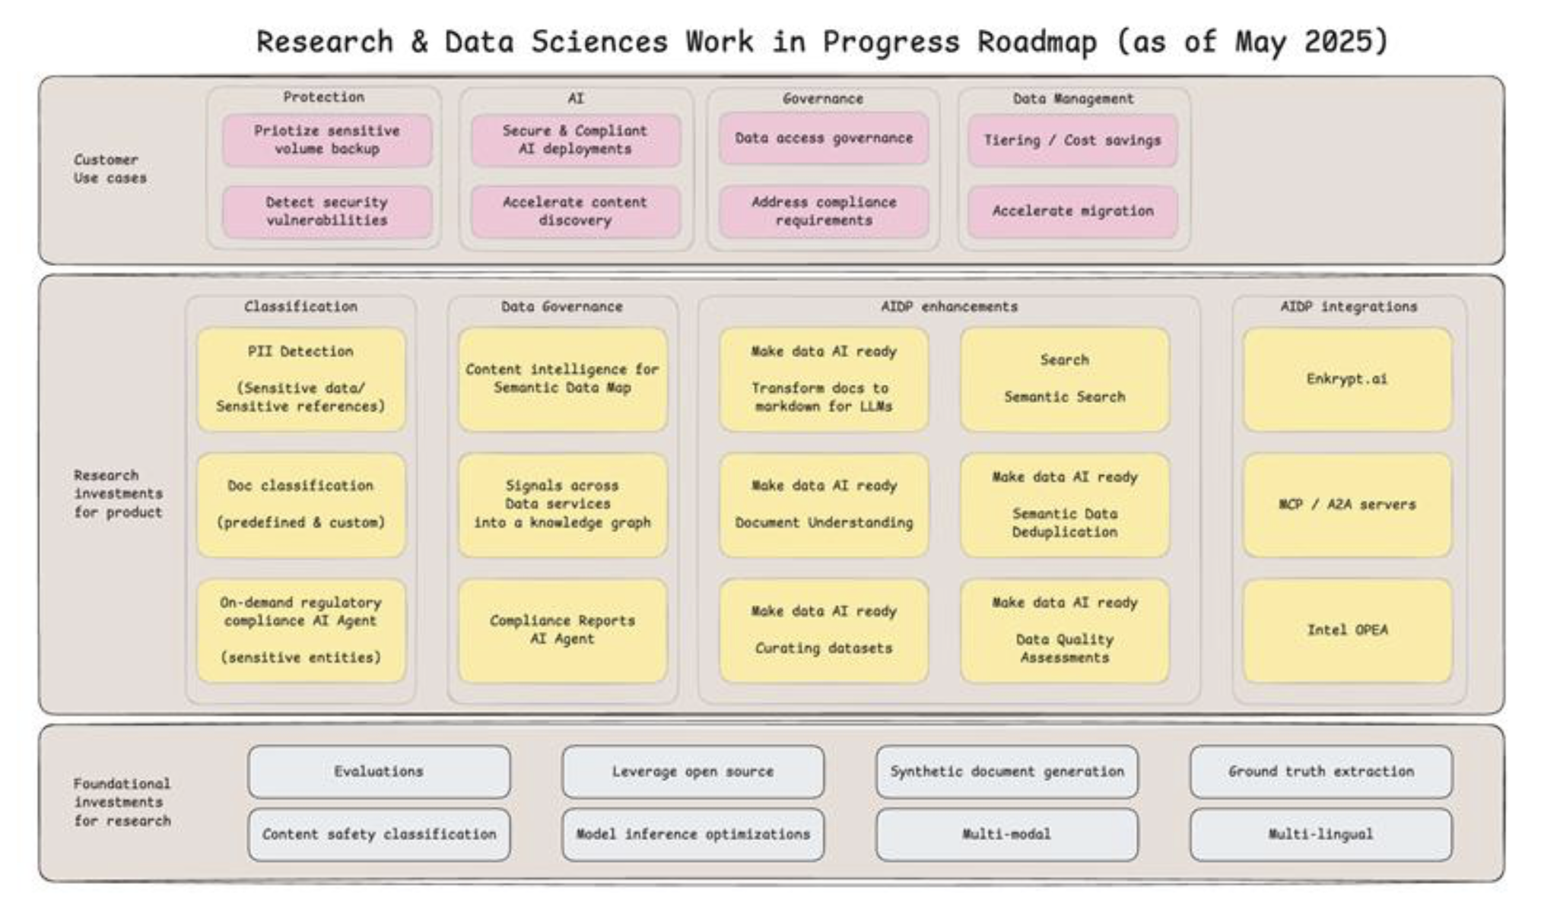
AI Roadmap

Slide 7
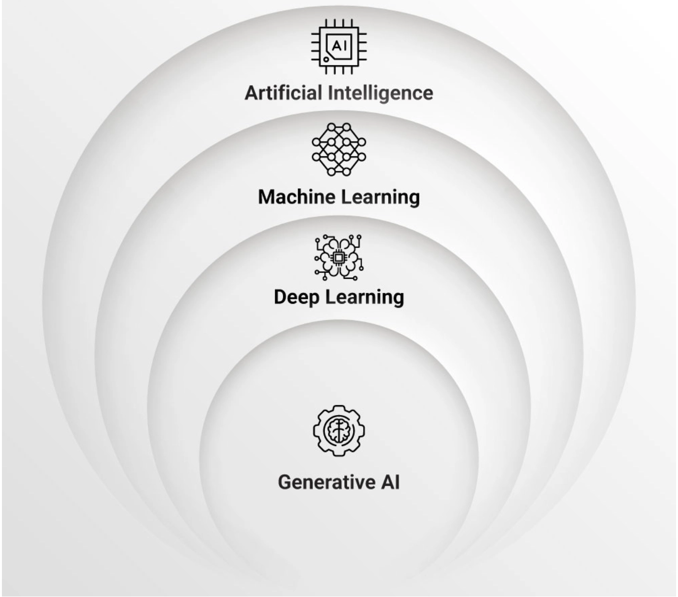
Intro
AI -The umbrella Term
The broadest concept, aiming to create machines that can simulate human-like intelligence, including problem-solving, learning, decision-making, and understanding.
Machine Learning (ML)- Teaching AI to learn from data
Can we classify / predict/ forecast the future based on historic data patterns
Deep Learning
Subset of ML which is Brain/Neuron Inspired
A specialized area of machine learning utilizing multi-layered neural networks inspired by the human brain to learn from vast amounts of data.
Generative AI -Creating new content
Deep Learning/Transformer based AI focused on creating new,
original content (e.g., text, images, music, videos)
by learning patterns from existing data

Slide 8
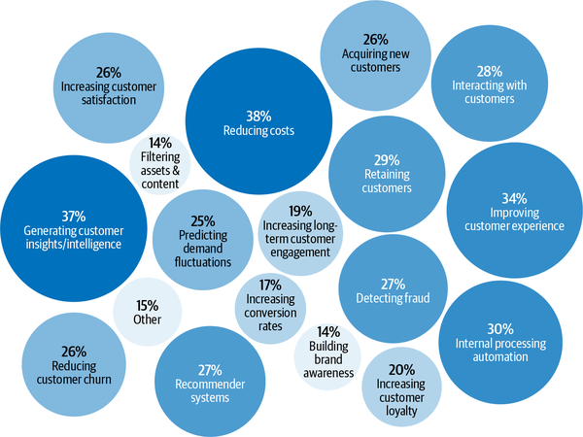
State of Enterprise Machine Learning

Slide 9
Loss / Cost Function
Loss Function quantifies the discrepancy between a model's predicted output and the true, actual value (often referred to as "ground truth") for a given input.
How a ML model is trained :
Prediction: The trained model makes a prediction for a given input data point.
Comparison: The loss function compares this prediction with the known actual value (ground truth).
Error Calculation: The loss function calculates a numerical value that represents the magnitude of the error or difference between the prediction and the actual value.
Parameter Adjustment: Optimization algorithms(Gradient Descent) use this calculated loss (and its gradient) to determine
how to adjust the model's parameters to reduce the error in subsequent predictions.
This iterative adjustment process continues until the loss is minimized to an acceptable level
Hyper Parameter Tuning
To Prevent Overfitting , and Underfitting Hyper parameters are passed to model such as Regularization strength, Learning rate,
Max depth , epochs , etc

Slide 10
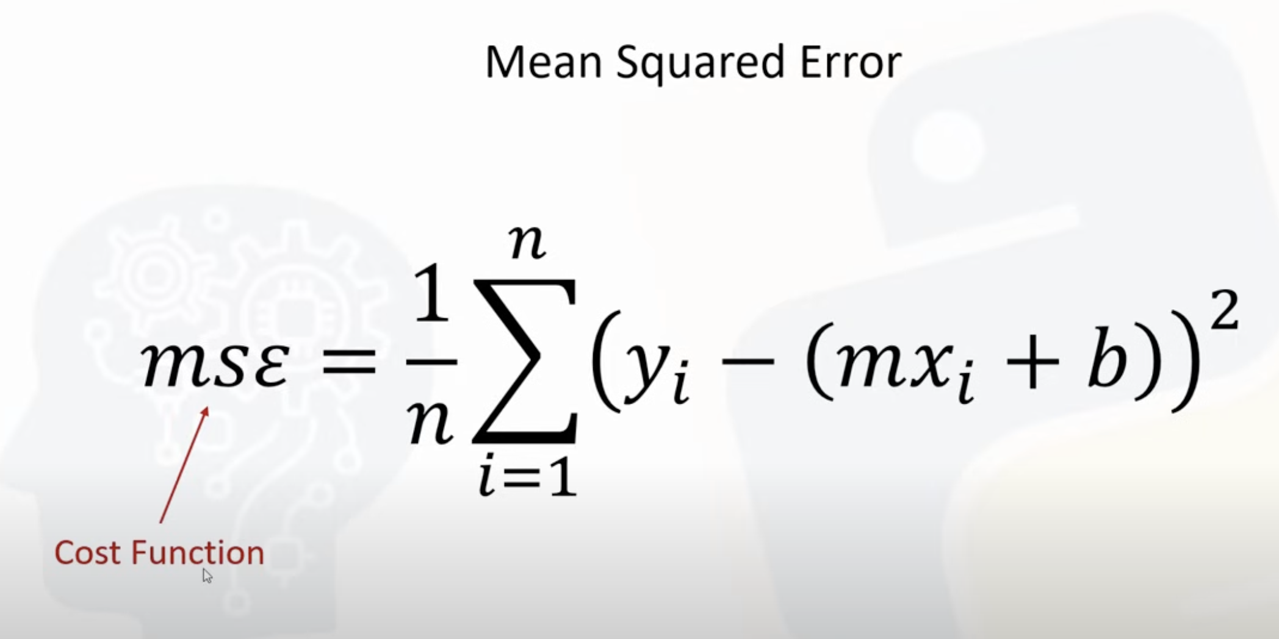
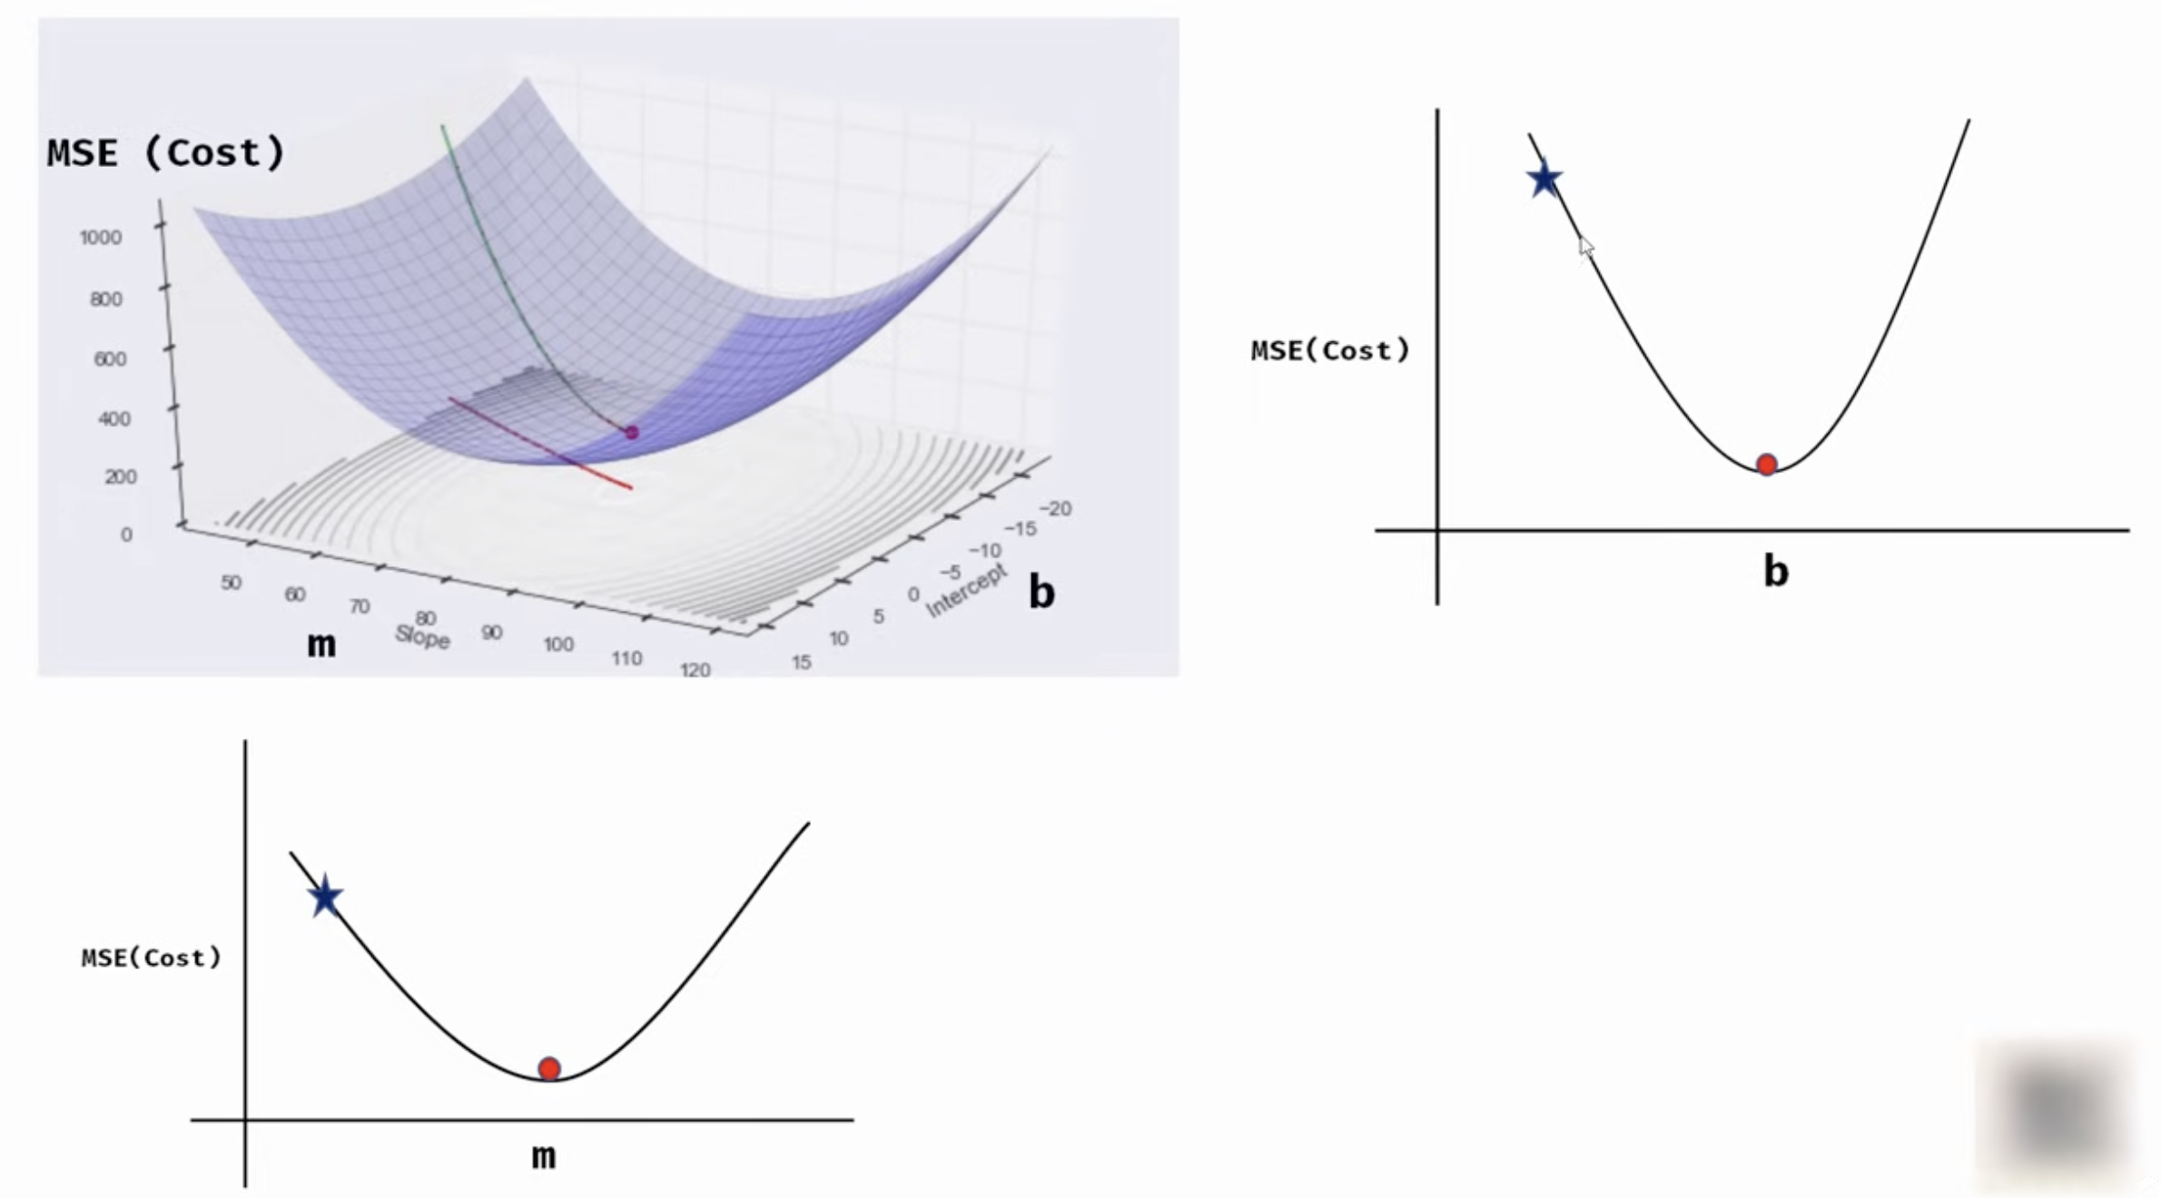

Gradient Descend
Gradient descent is an iterative optimization algorithm used to find the local minimum of a differentiable function, often referred to as a "cost function" or "loss function" in machine learning.
Used to find the best fit line
To learn more about calculus and Derivate :

Slide 11
Demo

Slide 12
Exercise
Work on a Kaggle problem (California Housing)
Deploy in a Kubernetes cluster
Setup tests and monitoring

Slide 13
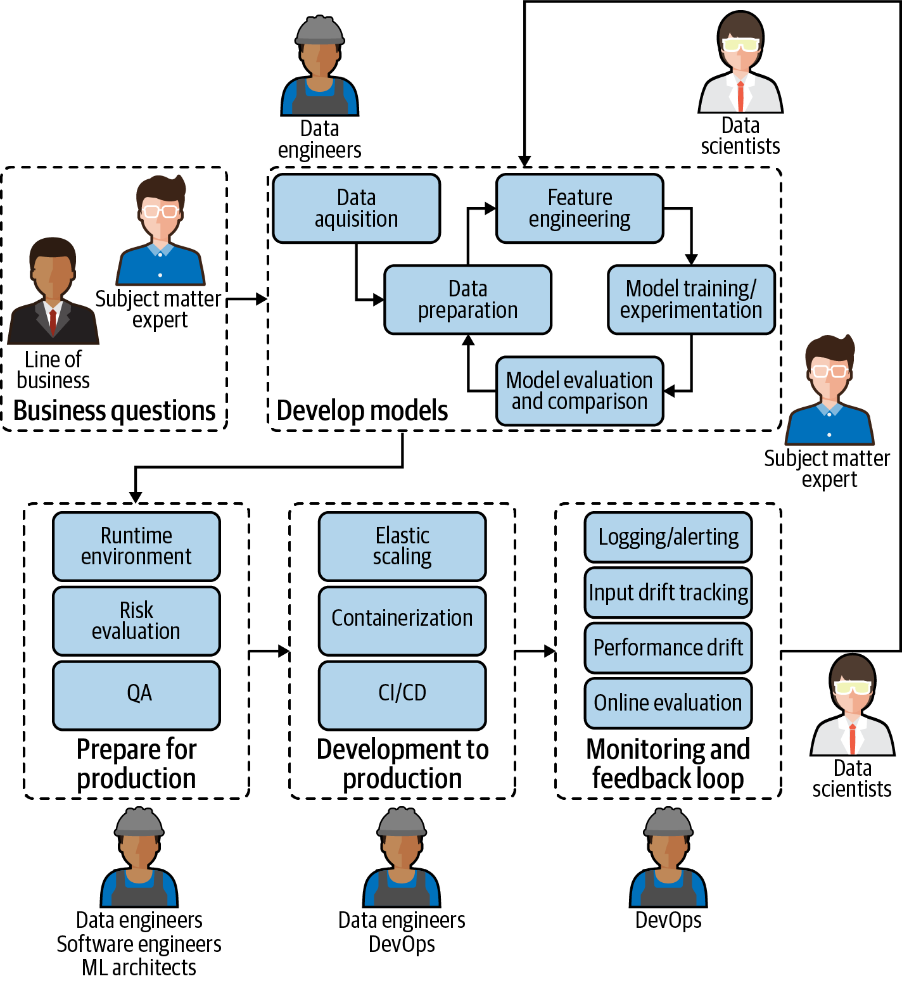
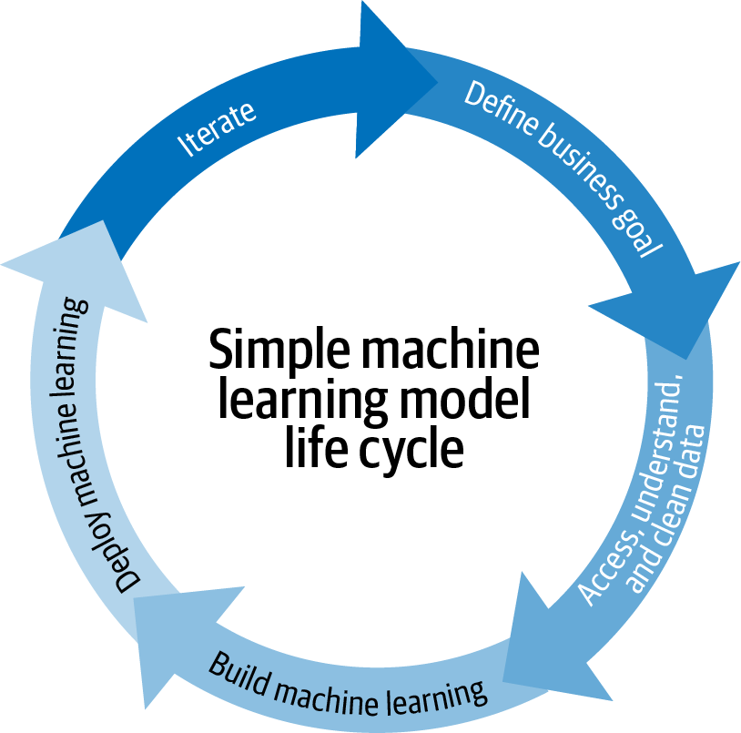
ML Simplified Life Cycle
Reality

Slide 14
Feature | DevOps | MLOps
Focus | Automating and optimizing the software development lifecycle. | Automating and optimizing the machine learning (ML) model lifecycle, including data pipelines, training, deployment, and monitoring.
Primary Goal | Accelerate software delivery and ensure continuous, reliable updates. | Faster deployment of ML models, better accuracy over time, and stronger assurance they provide business value.
Core Components | Software development, IT operations, CI/CD, infrastructure automation, monitoring. | Data preparation, model training & tuning, model deployment, model monitoring, automated retraining, version control for data, code, and models, CI/CD, infrastructure as code (IaC).
Artifacts Managed | Source code, binaries, configurations, test reports. | Code, data, features, models, hyperparameters, experiment configurations, evaluation metrics, logs.
Lifecycle | Linear and predictable: Code -> Test -> Release. | Cyclical and iterative: Data -> Training -> Evaluation -> Deployment -> Monitoring -> Retraining.
Data Emphasis | Less emphasis on data management and versioning compared to MLOps. | Strong emphasis on managing large, evolving datasets, data quality, feature engineering, and data versioning.
Monitoring Focus | Application performance, uptime, error rates, resource utilization. | Model performance (accuracy, latency), data drift, concept drift, bias, fairness, model interpretability, business metrics related to the model's performance.
Team Structure | Developers and IT operations teams working collaboratively. | Business Partners, Data scientists, ML engineers, data engineers, and operations teams collaborating across the ML lifecycle.
Key Challenges | Configuration management, toolchain complexity, cultural resistance. | Managing data dependencies, version control for models and data, addressing model drift, ensuring reproducibility, and managing specialized infrastructure (e.g., GPUs).
Tools | Jenkins, Git, Docker, Kubernetes, Terraform. | MLflow, Kubeflow, TensorFlow Extended, SageMaker, Airflow, Model Registries, Experiment Trackers.
DevOps Vs MLOps

Slide 15
A Robust MLOps System will
Keep track of versioning code, data and Model
Understand whether retrained models are better than the previous versions (and promoting models to production that are performing better) – Champion Vs Challenger
Ensure (at defined periods—daily, monthly, etc.) that model performance is not degrading in production
Ensures Feedback loop is automated for continuous Training and deployment

Slide 16
Primer on ML
Model Development(Data Engineering , Data Science)
Productionalization and Deployment (Software Engineering)
Monitoring(DevOps)
Iteration and Feedback Loop
Governance

Slide 17
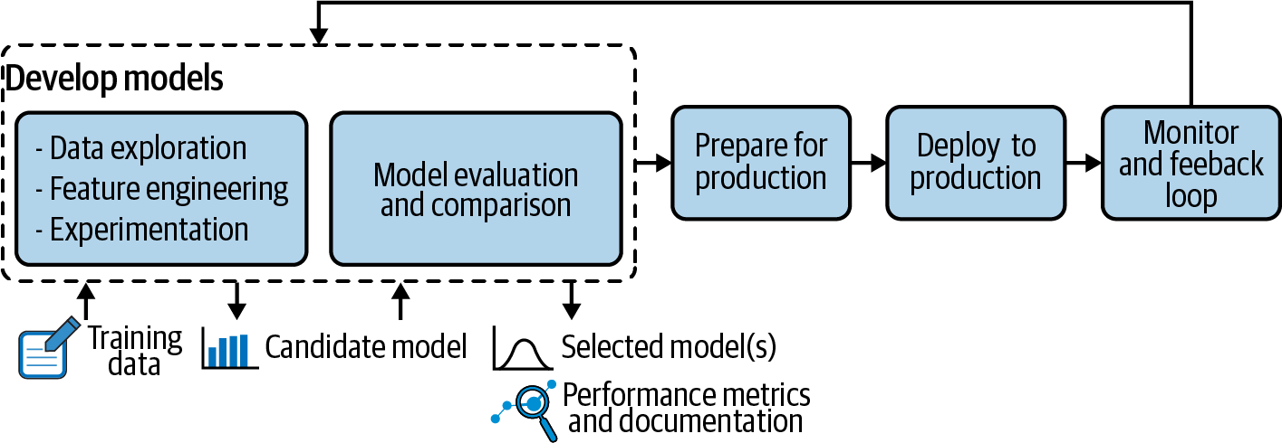
Model Development
ML Can be classified into
Supervised Learning
Unsupervised Learning
ML model algorithm can/will be selected based on the problem and different Tradeoffs (Performance Vs accuracy) .

Slide 18
Model Development- Components & Terminologies
Training data | Training data is usually labeled for the prediction case with examples of what is being modeled (supervised learning)
A performance metric | A performance metric is what the model being developed seeks to optimize.
ML algorithm | There are a variety of models that work in various ways and have different pros and cons. It is important to note that some algorithms are more suited to certain tasks than others, but their selection also depends on what needs to be prioritized: performance, stability, interpretability, computation cost, etc.
Hyperparameters | Hyperparameters are configurations for ML algorithms.
Evaluation dataset | Unseen data

Slide 19
Model Development -ML Ops considerations of Algorithms
Algorithm type | Name | MLOps considerations
Linear | Linear regression | There is a tendency for overfitting.But faster than trees
 | Logistic regression | There is a tendency for overfitting.But faster than trees
Tree-based | Decision tree | Can be unstable—small changes in data can lead to a large change in the structure of the optimal decision tree. But faster
 | Random forest | Predictions can be difficult to understand, which is challenging from a Responsible AI perspective. Random forest models can also be relatively slow to output predictions, which can present challenges for applications.
 | Gradient boosting | Like random forest, predictions can be difficult to understand. Also, a small change in the feature or training set can create radical changes in the model.
Deep learning | Neural networks | In terms of interpretability, deep learning models are almost impossible to understand. Deep learning algorithms, including neural networks, are also extremely slow to train and require a lot of power (and data). Is it worth the resources, or would a simpler model work just as well?

Slide 20
Model Development - EDA
Documenting how the data was collected and what assumptions were already made
Looking at summarizing statistics of the data: What is the domain of each column? Are there some rows with missing values? Obvious mistakes? Strange outliers? No outliers at all?
Taking a closer look at the distribution of the data
Cleaning, filling, reshaping, filtering, clipping, sampling, etc.
Checking correlations between the different columns, running statistical tests on some subpopulations, fitting distribution curves
Comparing that data to other data or models in the literature: Is there some usual information that seems to be missing? Is this data comparably distributed?

Slide 21
Model Development-Feature Engineering
Feature engineering category | Description
Derivatives | Infer new information from existing information—e.g., what day of the week is this date?
Enrichment | Add new external information—e.g., is this day a public holiday?
Encoding | Present the same information differently—e.g., day of the week or weekday versus weekend.
Combination | Link features together—e.g., the size of the backlog might need to be weighted by the complexity of the different items in it.

Slide 22
Model development-Feature Store- Design Pattern
Feature Engineering is typically a expensive operations during inference
Feature stores, are repositories of different features associated with business entities that are created and stored in a central location for easier reuse.
Offline Features -historical or batch-processed feature stored for tasks like model training and batch inference. For example, a customer's total spending over the past year for a recommendation system
Online Features -real-time or near real-time feature optimized for low-latency retrieval, typically used for real-time inference. An example past few mins how many times user tried to access the DB

Slide 23
Prepare for Prod
Challenges
Model Dev and Production Environments will be different
Tooling Challenges (pckl vs PMML Vs MOJO vs API)
Performance Considerations
Model Compression
Rewrite Python libraries to native prod code
Optimizations
Quantization , Pruning , Features & reference data in redis etc

Slide 24
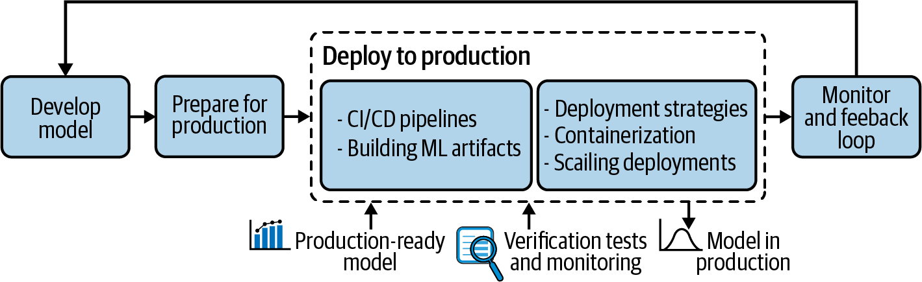
Deploy to Production
Build the model
Build the model artifacts
Send the artifacts to long-term storage
Run basic checks (smoke tests/sanity checks)
Generate fairness and explainability reports
Deploy to a test environment
Run tests to validate ML performance, computational performance
Validate manually
Deploy to production environment
Deploy the model as canary(Challenger)
Fully deploy the model

Slide 25
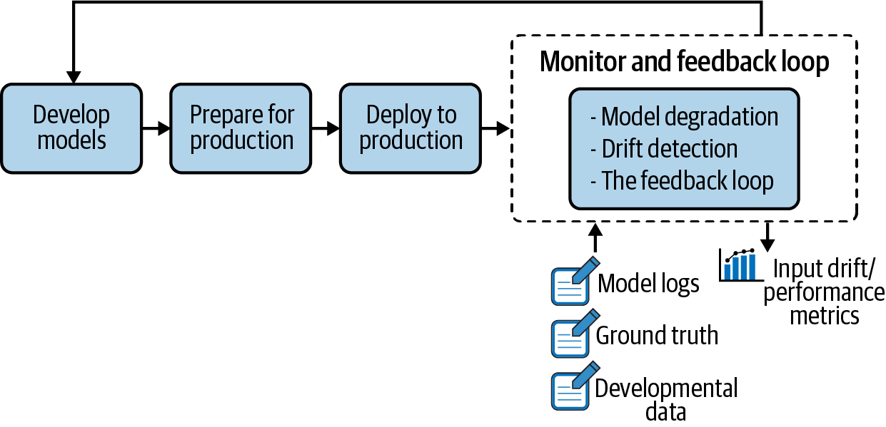
Monitoring & Feedback Loop
Monitoiring will be done
At the resource level, including ensuring the model is running correctly in the production environment. Key questions include: Is the system alive? Are the CPU, RAM, network usage, and disk space as expected? Are requests being processed at the expected rate?
At the performance level, meaning monitoring the pertinence of the model over time. Key questions include: Is the model still an accurate representation of the pattern of new incoming data? Is it performing as well as it did during the design phase? Drift Detection (Concept, Data , Prediction)

Slide 26
Logging Format
Model metadata
Identification of the model and the version.
Model inputs
Feature values of new observations, which allow for verification of whether the new incoming data is what the model was expecting and thus allowing for detection of data drift (as explained in the previous section).
Model outputs
Predictions made by the model that, along with the ground truth collected later on, give a concrete idea about the model performance in a production environment.
System action
How system acted based on model score
Model explanation
In some highly regulated domains such as finance or healthcare, predictions must come with an explanation. (Shap/Lime)

Slide 27
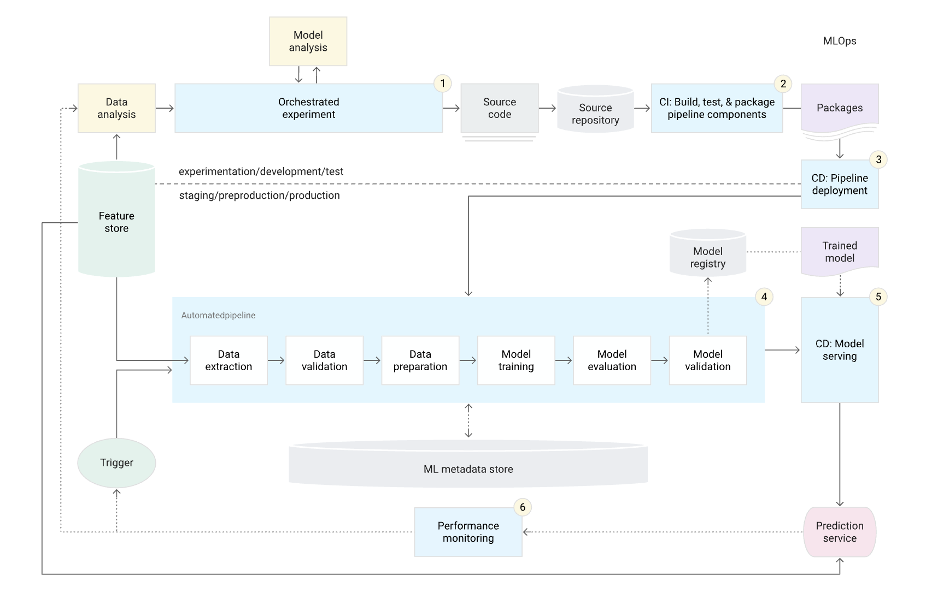
ML Ops
Fully automated ML Ops:
Source control
Test and build services
Deployment services
Model registry
Feature store
ML metadata store
ML pipeline orchestrator

Slide 28
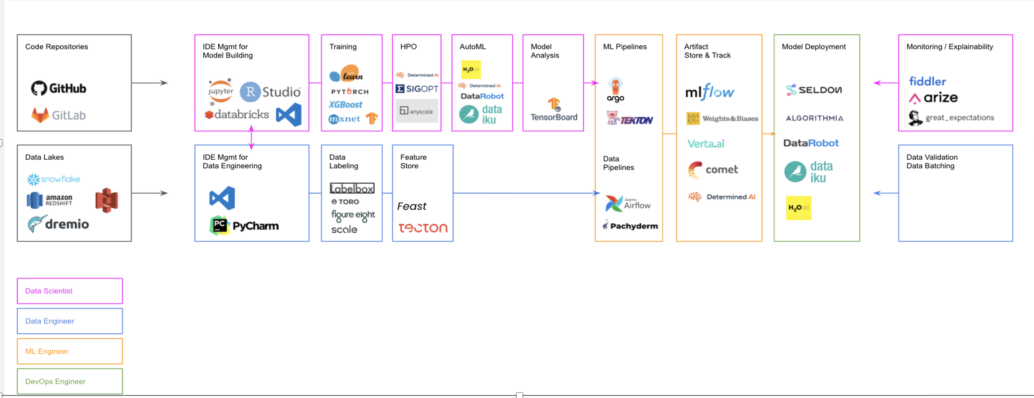
Open Source ML Landscape

Slide 29
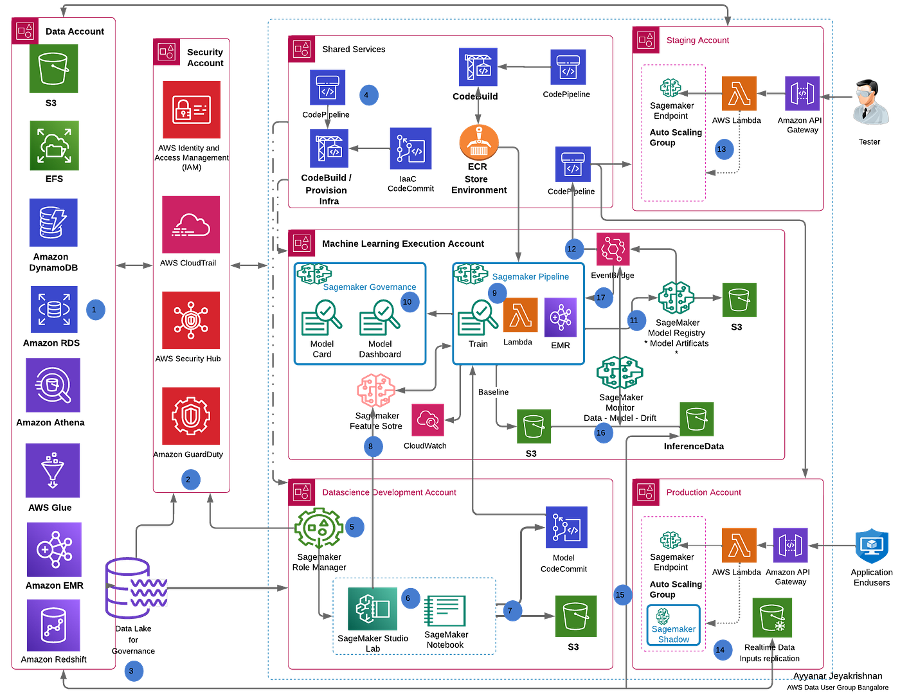
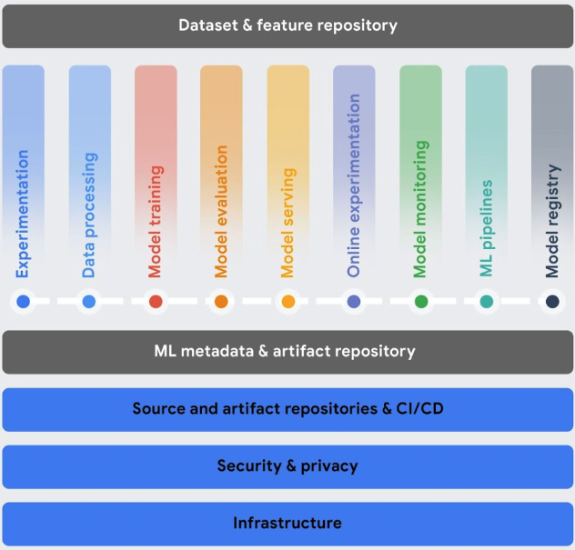
Cloud Landscape
AWS
GCP Vertex AI

Slide 30
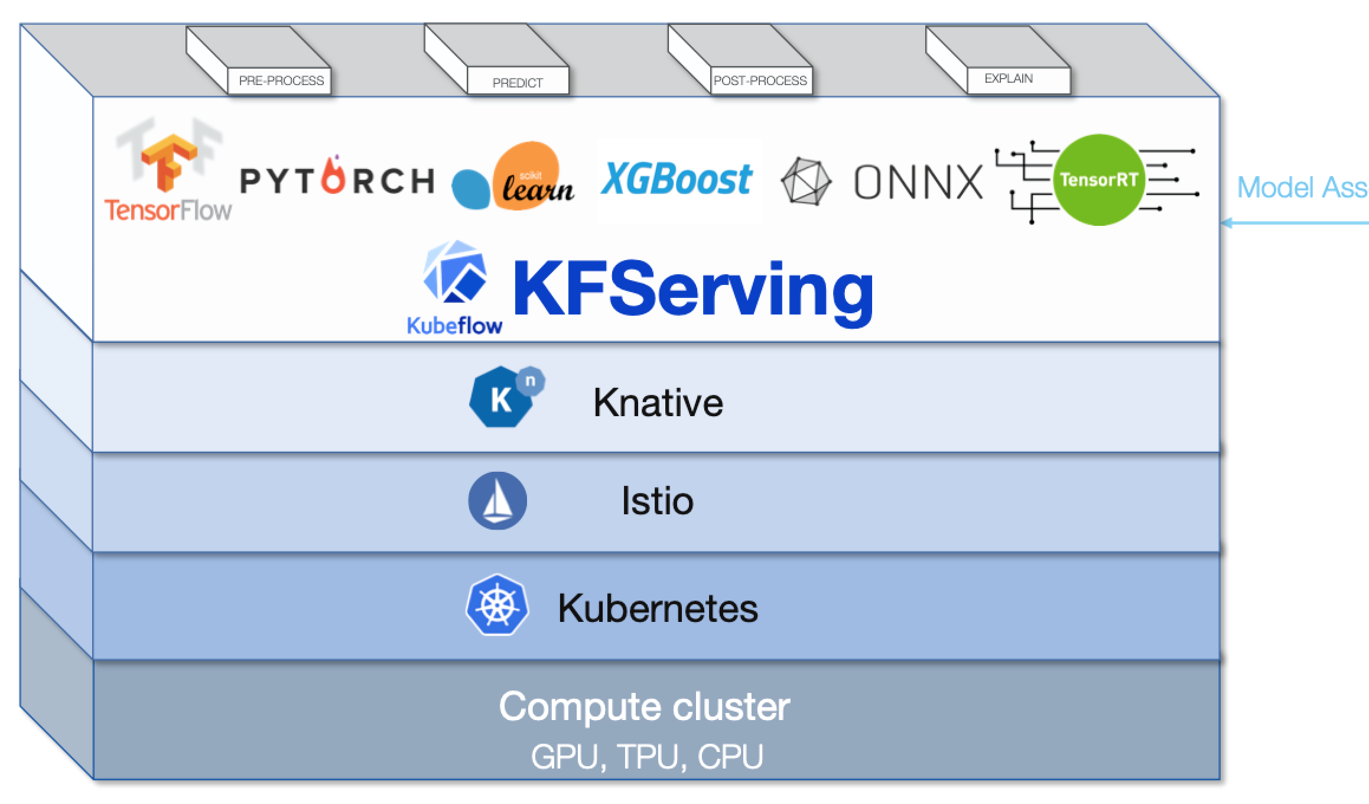
Open Source KubeFlow from Google, A Kubernetes based platform

